Slide 1

Adventureworks
Human Resources Department

Slide 2
HR OVERVIEW
There are 290 Employees. 206 are Men and 84 are women.
Bulk of the employees are in the Manufacturing Department, mainly in the Production unit.
90% of the employees are below 45 years of age.
There’s over 15000 available leave hours.
Average duration with the company is around 5 years.
Most of the employees are from North America.

Slide 3
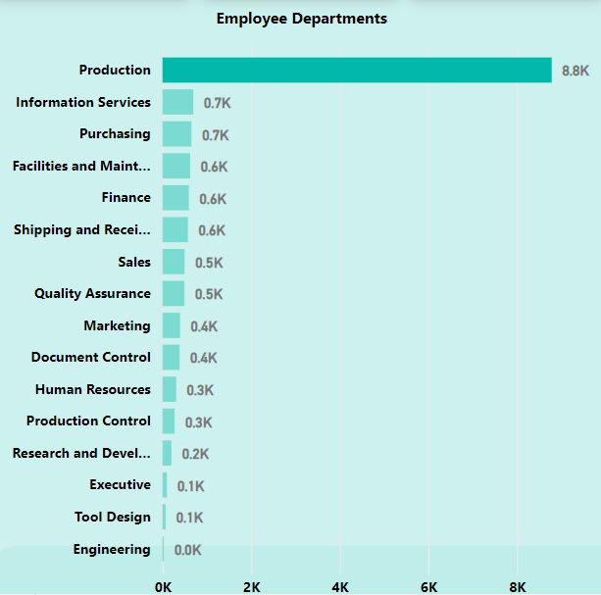
Leave Days
There’s over 15000 available vacation days.
Employees with the highest number of leave days close to 90 days(3 months) are from the Production Department.
This is a potential cost to the company.

Slide 4
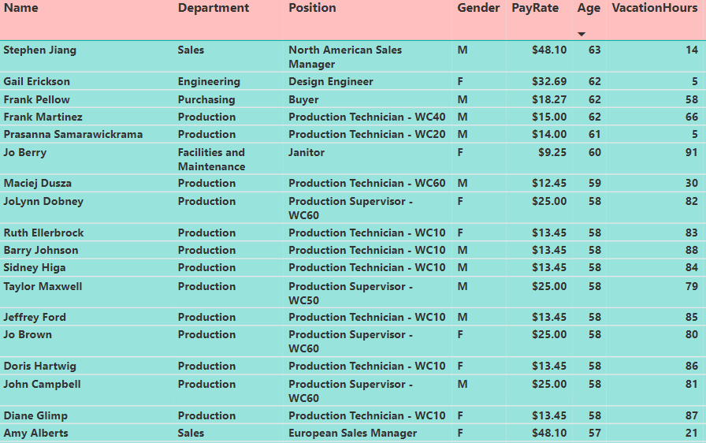
Leave days with age
Those who are above 50 years of age nearing retirement are also not taking their leave days.
There’s a high risk of getting those leave days paid out.

Slide 5
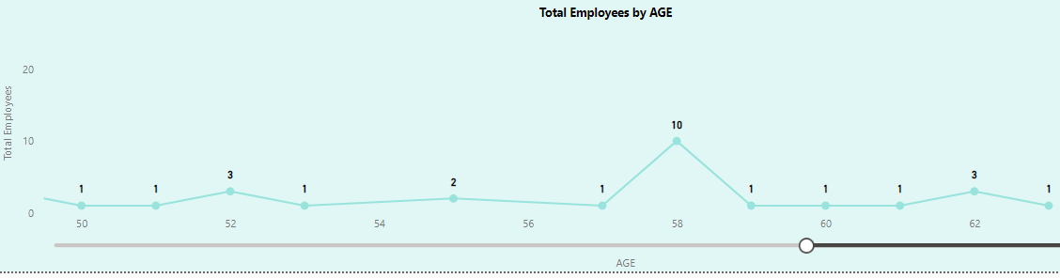
Employee Age ANALYSIS
There are around 26 employees who are over 50 years of age and nearing retirement. Bulk of them are 58 years of age from the Manufacturing Department with Managerial and Supervisor roles.

Slide 6
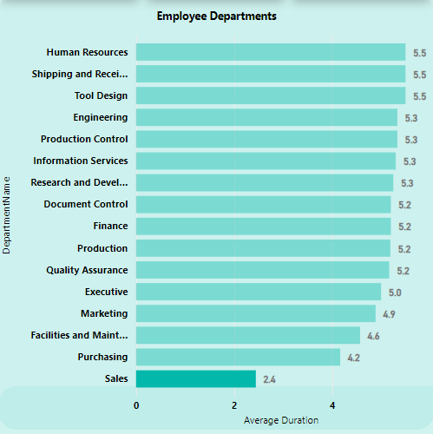
Employee Retention
The average retention or duration for all employees is about 5 years with the company.
Drilling down to retention by department, people in the sales department have a high turnover and the average duration is around 2 years.

Slide 7
Recommendations
HR management must look into the Production team to make sure that their working arrangements allows them to take some time off to clear the vacation leave days and reducing costs to the company in the long run.
The company should have a succession planning strategy for the employees that are nearing retirement age.
HR management might need to look into their Employee Retention rate to ensure that there are incentives or benefit for employees to stay longer. This will help with the culture of the organisation.

Slide 8
Conclusion
The HR management needs to make sure that people are taking their leave days across all the departments and make sure they avoid cost to the company.

